Slide 1
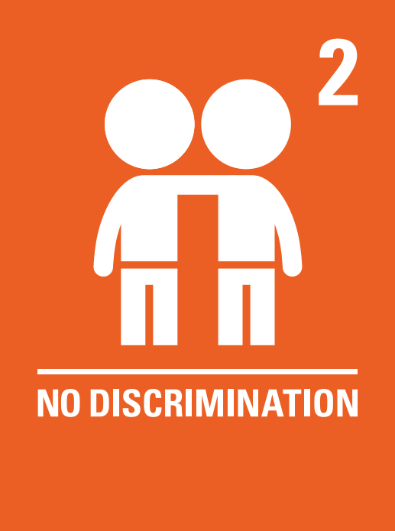
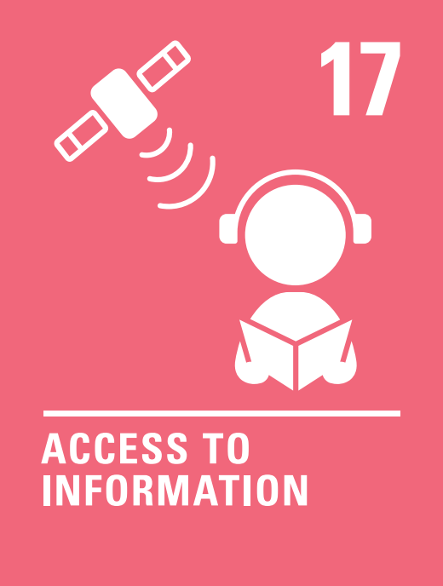

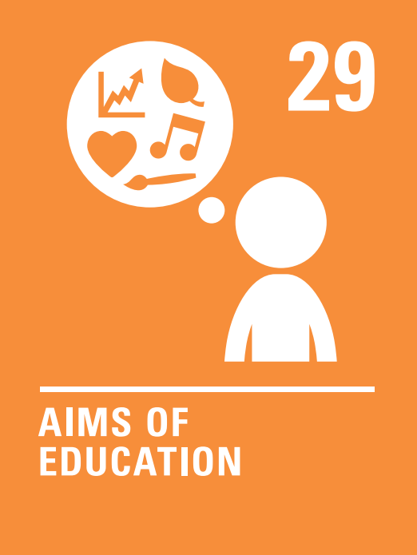
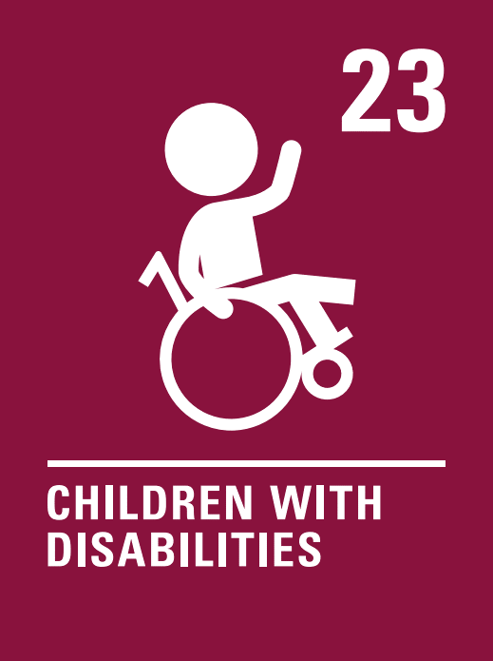

Coverage Spring 1 2024
Week | News Story | Focus Question | British Value Link | Protected Characteristics | UN Article
8th January | 10-year-old Teddy Cottle from Oxfordshire has launched a petition calling for Apple to change the glasses emoji, also known as the ‘nerd’ emoji, as he says it gives the wrong impression of glasses-wearers. | Are emojis an important part of communication? | Mutual Respect and Tolerance | All
15th January | A study from the University of Valencia, in Spain, found that print reading could boost skills by six to eight times more than digital reading, for example, on an e-reader or tablet. | Is an e-reader better than a book? | Individual Liberty | Religion and Belief
22nd January | Motorists in Britain could be completing journeys using driverless cars by 2026 the transport secretary, Mark Harper, has predicted. | Will self-driving vehicles change our lives? | Rule of Law | Disability
29th January | A new BBC television programme, called Style It Out, gives nine young promising fashion designers from all over the UK the chance to compete in designing different outfits. The winner will have their clothes showcased at London Fashion Week. | Is fashion important? | Individual Liberty | Religion and Belief
5th February | 45-year-old Mar Galcerán from Spain has become the country’s first elected parliamentarian with Down's syndrome. | What makes someone inspirational? | Democracy | Disability
12th February | Pupils in England will have the choice to take a GCSE exam in British Sign Language (BSL) from 2025. BSL is a form of communication using hand gestures and other movements. | Should we learn sign language at school? | Mutual Respect and Tolerance | Race
© Picture News 2024

